Slide 1

DOC 314
Digital Skills for Higher Education
DILKI WEERAKOON
MODULE LEADER: JANANIE MAYOORESAN

Slide 2
Module Team
Ms. Jananie Mayooresan (email: jananie.m@iit.ac.lk)
Ms. Dilki Weerakoon (email: dilki.w@iit.ac.lk)
Ms. Savindi Weerakoon (email: savindi.w@iit.ac.lk)

Slide 3
How is the module delivered?
This is a 15-credit module delivered in one semester.
You will have:
  1 - Lecture
  1- Tutorial, sessions every week.
Attendance and engagement with the module is compulsory; If you don’t engage with the module, you will FAIL and at a possible risk of not progressing to first year or even being excluded from the course.
This module provides the foundation for your modules at L4, L5 and L6.

Slide 4

Assessment
100% coursework
  In-Class Test -1 (MCQ) - 15%
  Presentation & Report - 30%
  In-Class Test- 2 (Practical Test)- 50%
  Attendance & Behaviour - 5%

Slide 5
Module Aim
To provide an introduction to Information Technology, operating systems, application software of Microsoft Office and Graphics.
The course provides an understanding of the basic operations of a computer and associated software and hardware. Microsoft office is used for practical experience.

Slide 6
Learning Outcomes
LO1: Obtain a basic knowledge of Computer Systems and It’s components, and Network
LO2: Obtain a basic knowledge of operating system and its functions
LO3: Carry out basic filing and housekeeping operations on a personal computer
LO4: Develop a formatted document using a Microsoft Office Word
LO5: Develop a financial projection using a Microsoft Excel
LO6: Develop an effective presentation with Microsoft PowerPoint
LO7: Obtain a basic knowledge on using Internet and Email
LO8: Obtain a basic knowledge on using Graphic Application

Slide 7
Reference Books
1. Cox, J. and Lambert, J., (2011) Word 2010 step by step. India: Prentice Hall.
2. Dodge, M. and Stinson, C., (2011) Excel 2010 Inside-out. India: PHI Learning.
3. Dodge, M. and Stinson, C., (2011). Excel 2010 inside out. India: Prentice Hall.
4. Frye, D., (2010). Microsoft excel plain and simple. India: Prentice Hall.
5. Norton, P., (2006). Introduction to Computers. New Delhi: Tata McGraw Hill.

Slide 8
Internet Resources
Microsoft, (2013). Office 2010 User resources. [Online]. Available from: http://www.microsoft.com.
Microsoft, (2013). Windows: Introduction to computers. [Online]. Available from: http://windows.microsoft.com/en-us/windows-vista/introduction-to-computers

Slide 9
Information Systems (I)
LECTURE 1

Slide 10

What is an Information System?

Slide 11
Defining Information Systems
“Information systems are combinations of hardware, software, and telecommunications networks that people build and use to collect, create, and distribute useful data, typically in organizational settings.”
“Information systems are interrelated components working together to collect, process, store, and disseminate information to support decision making, coordination, control, analysis, and visualization in an organization.”

Slide 12

What are the 2 keywords you have identified in the definition of Information Systems?
Notes:
Components
Role

Slide 13
The Components of Information Systems
Information systems are made up of five components:
Hardware
Software
Data
People
Process

Slide 14
The Components of Information Systems
Hardware: Part of an information system you can touch – the physical components of the technology.
Software: Set of instructions that tells the hardware what to do. Software is not tangible – it cannot be touched.
Data: Raw facts. By themselves, pieces of data are not really very useful. But aggregated, indexed, and organized together into a database, data can become a powerful tool for businesses.

Slide 15
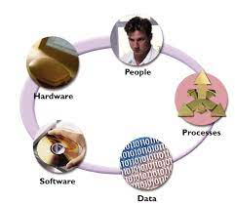
The Components of Information Systems
People: From the front-line help-desk workers, to systems analysts, to programmers, all the way up to the chief information officer (CIO), the people involved with information systems are an essential element that must not be overlooked.
Process: Series of steps undertaken to achieve a desired outcome or goal.

Slide 16
Task 1: Homework
We all interact with various information systems every day: at the grocery store, at work, at school, even in our cars (at least some of us). Make a list of the different information systems you interact with every day. See if you can identify the hardware, software, data, people, and processes involved in making these systems work.

Slide 17
The Role of Information Systems
What do these components do for an organization?
Collect, store, organize, and distribute data throughout the organization.
Take data and turn it into information, and then transform that into organizational knowledge.

Slide 18
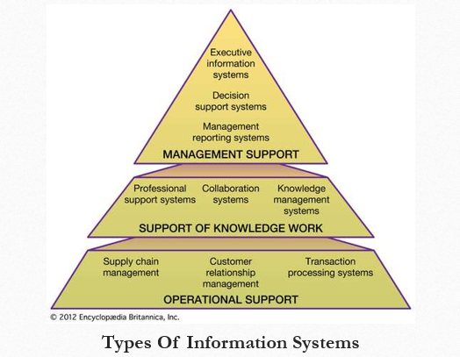

Slide 19
Information Systems Security and Control
Information systems security is responsible for the integrity and safety of system resources and activities.
Information systems are vulnerable to a number of threats and require strict controls, such as continuing countermeasures and regular audits to ensure that the system remains secure.
https://www.informationisbeautiful.net/visualizations/worlds-biggest-data-breaches-hacks/

Slide 20
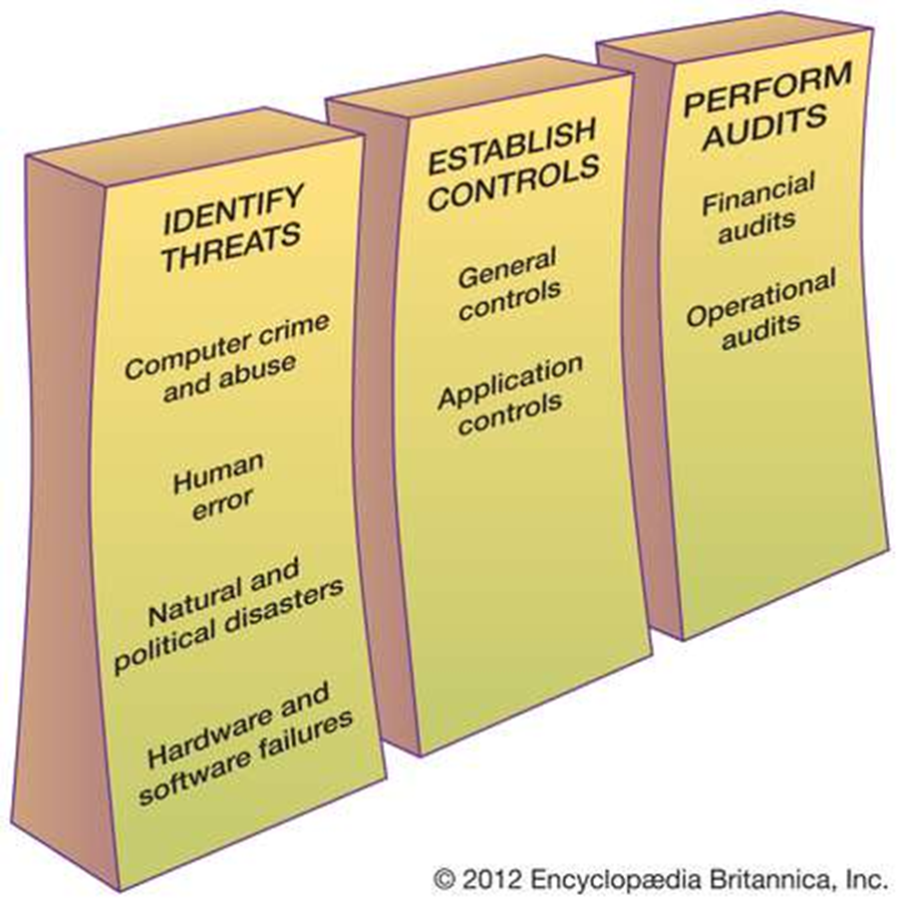

Slide 21
Information Systems Audit
The effectiveness of an information system’s controls is evaluated through an information systems audit.
An audit aims to establish whether information systems are safeguarding corporate assets, maintaining the integrity of stored and communicated data, supporting corporate objectives effectively, and operating efficiently.

Slide 22
Organizational Impacts of Information Systems
Information systems support for;
business operations
individual and group decision making
innovation through new product and process development
relationships with customers, suppliers, and partners
pursuit of competitive advantage
lower the costs of communication among workers and firms

Slide 23

Do you know?
The use of information systems has enabled new organizational structures.
Virtual organizations have emerged that do not rely on physical offices and standard organizational charts.

